Slide 1
Embedding Optimization for NLP interpretation
Advanced Deep Learning 2020
Carl Borngrund, Karl Ekström, Konstantina Nikolaidou

Slide 2
Overview
Motivation
Related Work
Goal
Implementation
Experiment Setup
Results
Discussion
Future Work

Slide 3
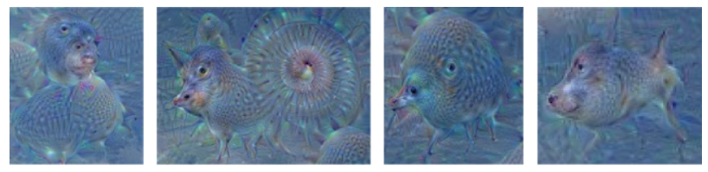
Motivation
The Building Blocks of Interpretability that demonstrates a unifying way to visualize the role of elements of an image.
Interpretable representations of neurons for computer vision DNNs, Google Deep Dream.

Slide 4
Related Work
Feature Visualization - C. Olah et al
Visualizing what images activate a CNN
The Building Blocks of Interpretability - C. Olah et al
What a CNN looks for, and where
Visualizing and understanding neural models in NLP – D. Jurafsky et al
Interpret NN for language-based tasks using saliency maps for sentences
Representation of linguistic form and function in recurrent neural networks – A. Kádár et al
Analyze activation patterns in RNNs from a linguistic point of view

Slide 5
goal
Mirror the approach of producing image feature visualization as text-based feature visualization.
Optimize embeddings to maximize activations in a pre-trained model for text classification.

Slide 6
Theory
Visualizing an image feature is done by training an image to optimize a neuron/channel/layer activation
Images are of fixed dimension, words are not
Instead of words we train embeddings
Challenge: Images are easy to visualize, embeddings are not

Slide 7
implementation
Input text
Word2Vec
Embedding
Sentiment Analysis
Classification
Embedding training
Feature Visualization

Slide 8
implementation
Implementation built on top of work done in Word2Vec: Optimal Hyper-Parameters and Their Impact on NLP Downstream Tasks
We use pre-trained Word2Vec CBOW embeddings of dimension 300.
We train an LSTM on the IMDB data set for sentiment analysis (SA) classification.
Freeze this network

Slide 9
IMPLEMENTATION
Choose a word from the corpus and embed it
Train this embedding using maximization of activations in a layer
This is done by hooking a layer and using the mean of the activations as the loss
We then use normal backprop on the input embedding
This moves the input through the embedding space
Then use PCA or t-SNE to project the embeddings
The embedding movement and closest words

Slide 10
EXPERIMENT SETUP
Train the network on the downstream task (SA)
Optimizer: Adam
Loss function: BCE
LR: 10^-3
Batch size: 64
Max length of sentences: 250
Stop training after 10 epochs with no improvement to the validation accuracy

Slide 11
EXPERIMENT SETUP
Train an input word
Randomly chosen from vocabulary or user input
Optimizer: Adam
LR: 10^-3
Loss function: Maximize/Minimize activation in the last fully connected layer
Epochs: 20000

Slide 12
Experiment Setup
Train an adversarial example
Choose a word and train the embedding
Add the trained embedding to the original embedding to alter the SA value
Downscale the trained embedding until the SA is at an appropriate level
Check the norms to see the relative change in embedding

Slide 13
Results – optimal embedding
Input Word | Activation before | Activation after | Grad Pos/neg | SA
olympus | 0.71 | -24.35 | Pos | 0
gfriend | 0.64 | -24.13 | Pos | 0
iffr | 0.72 | -24.36 | Pos | 0
horrorexplicit | 0.24 | 24.78 | Neg | 1
homesteading | -0.72 | 24.78 | Neg | 1
landmark | 1.88 | 24.19 | Neg | 1

Slide 14
Results – adversarial attack
An adversarial attack that makes all reviews negative
Input Word | SA before | SA after | Norm input | Norm perturb | Norm after
good | 0.84 | 0.098 | 30.69 | 15.34 | 35.99
excellent | 0.77 | 0.096 | 27.98 | 14.97 | 32.60
awful | 0.30 | 0.091 | 31.65 | 5.60 | 33.24
mediocre | 0.581 | 0.093 | 27.082 | 10.41 | 30.16

Slide 15
RESULTS – ADVERSARIAL ATTACK
An adversarial attack that makes all reviews positive
Input Word | SA before | SA after | Norm input | Norm perturb | Norm after
good | 0.84 | 0.90 | 30.69 | 2.23 | 30.95
excellent | 0.77 | 0.90 | 27.98 | 3.69 | 28.90
awful | 0.30 | 0.90 | 31.65 | 15.48 | 36.81
mediocre | 0.581 | 0.92 | 27.082 | 5.86 | 28.46

Slide 16
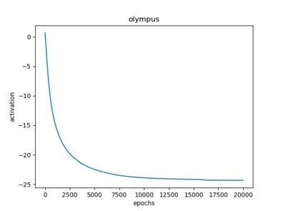
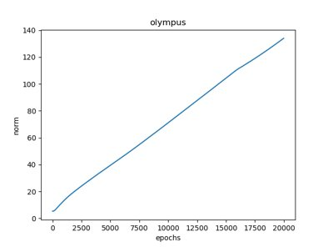
Results per epoch

Slide 17
EMBEDDING DRIFT PCA

Slide 18
EMBEDDING DRIFT t-sne

Slide 19
Discussion
We manage to train embeddings to optimize activations
Only the output layer though
We visualize the features through t-SNE and PCA
This visualization is difficult to interpret however
The trained embedding moves away from the corpus
We do not implement a saliency map-esque building block to show where the network looks

Slide 20
Future Work
Back propagation through embedding to input space (train words)
Further develop projections to visualize the results
Examine why activations converge to ±25?
Develop saliency maps to explain how the optimal embeddings serve as building blocks of a normal embedding (attention?)

Slide 21
Thank you for listening Questions?

